Slide 1
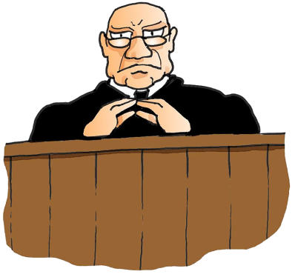
Types of Mens Rea
Unit 26

Slide 2

Direct Intention
Scenario
A landlord owns a row of shops, he decides he wants to get rid of the tenants but as they do not want to move out straight away due to their tenancy agreement, he decides to scare them by setting fire to the premises. Committing ‘Arson’.
He achieves this and the business owners (tenants) move out as they are scared. This is ‘Direct Intention’

Slide 3

Indirect Intention
Scenario
A landlord owns a row of shops, he decides he wants to get rid of the tenants but as they do not want to move out straight away due to their tenancy agreement, he decides to scare them by setting fire to the premises. Committing ‘Arson’.
Due to the arson attack an employee of one of the business dies. This is ‘Indirect Intention’

Slide 4

Recklessness
Scenario
Two shops on a High Street, one shop owner of Shop A decides to break into the next shop (Shop B) by the basement and decides to steal the cash from their gas meter. By doing this he damages the meter which causes a gas leak into shop B. The owner of Shop B then becomes ill due to carbon monoxide poisoning.
Shop owner A is charged with recklessness as there was no intention of hurting Shop Owner B

Slide 5
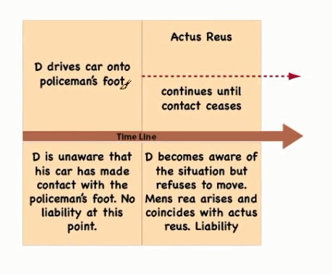
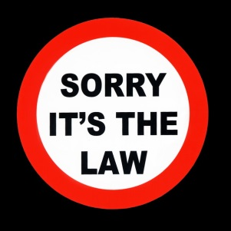
Coincidence
Fagan
V
Metropolitan Police 1969

Slide 6

Transferred Malice
Transferred malice is where the Mens Rea of the crime directed at one person is transferred to the unintended victim of the crime.
Scenario
A man gets into an argument with a group of men outside a public house. He decides to throw a brick at the group but misses. The brick goes through the window and hits the barmaid who is collecting glasses at the table near the window.
It was not the intention to hurt the barmaid as the malice was to the group of men but the malice has been transferred to the barmaid.

Slide 7
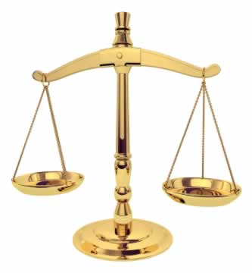
Strict Liability
Mens Rea not needed, just performing the act is sufficient. More based on regulations as it is evident there is criminal liability.
Scenario
A shop keeper sells cigarettes to someone who they believe to be over the age of 21 but in fact they are under 16 years of age.
There is no defence as there is direct ‘criminal liability’, Actus Reus is adequate. Usually more common with traffic offences such as speeding, parking, selling alcohol or lottery tickets to under age individuals, etc.

